Slide 1
Introduction
HDL is a language that describes the hardware of digital systems in a textual form.
It is specifically oriented to describing hardware structures and behaviors.
This language represents extensive parallel operations.
The most common use of a HDL is to provide an alternative to schematics.

Slide 2
Describe hardware at varying levels of abstraction
Structural description
Textual replacement for schematic.
Hierarchical composition of modules from primitives.
Eg: each logic gate instantiated and connected to others.
Behavioral/functional description
Describes input/output behavior of circuit
Synthesis generates circuit for module
Eg: Different implementations of one Boolean function
Simulation semantics.

Slide 3
The structural description can be used as input to logic simulation just as a schematic is used.
Models for each of the primitive components are required.
HDL can be used to represent logic diagrams, Boolean expressions, and other more complex digital circuits.
There are two applications of HDL processing: Simulation and Synthesis.

Slide 4
Simulator
A simulator interprets the HDL description and produces a readable output, such as a timing diagram.
It allows the detection of functional errors in a design without having to physically create the circuit.
The stimulus that tests the functionality of the design is called a test bench.
To simulate a digital system
First describe the design in HDL
Verified by simulating the design with a test bench

Slide 5
Types of HDL
There are two standard HDL’s are supported by IEEE.
VHDL (Very-High-Speed Integrated Circuits Hardware Description Language).
Developed by US. Dept. of Defense
Verilog HDL
Developed by Cadence Data Systems

Slide 6
Verilog
Verilog HDL has a syntax that describes precisely the legal constructs that can be used in the language.
It used about 100 keywords pre defined, lowercase, identifiers that define the language constructs.
Keywords Ex: module, endmodule, input, output, wire, and, or, not etc.,
Any text between two slashes(//) and the end of line is interpreted as a comment.
Blank spaces are ignored and names are case sensitive.

Slide 7
Lexical Conventions
Keywords, e. g., module, are reserved and in all lower case letters. Verilog is case sensitive.
Spaces are important in that they delimit tokens in the language.
Numbers are specified in the traditional form of a series of digits with or without a sign but also in the following form:
<size><base format><number>
<size>: number of bits (optional)
<base format>: is the single character ' followed by one of the following characters b, d, o and h, which stand for binary, decimal, octal and hex, respectively.
<number>: contains digits which are legal for the <base format>

Slide 8
549 // decimal number
24'h 8FF // hex number
10'o765 // octal number
4'b11 // 4-bit binary number 0011
3'b10x // 3-bit binary number with least significant bit unknown
5'd3 // 5-bit decimal number
-4'b11 // 4-bit two's complement of 0011 or 1101

Slide 9
String: is a sequence of characters enclosed in double quotes. "this is a string“
Operators (some examples:)
Arithmetic: +, - ! ~ * /
Shift: << >> Relational: < <= > >= == != === !==
Logical && ||.
Identifier: Equivalent to variable names: Identifiers can be up to 1024 characters.

Slide 10
Program Structure
A digital system as a set of modules
Each module has an interface to other module (connectivity)
GOOD PRACTICE: place one module per file ( not a requirement)
Modules may run concurrently
Usually one top level module which invokes instances of other modules
Usually called a stimulus block

Slide 11
MODULES
Represent bits of hardware ranging from simple gates to complete systems, e. g., a microprocessor.
Can either be specified behaviorally or structurally (or a combination of the two)
The structure of a module is the following:
module <module name> (<port list>); <declares> <module items> endmodule
<module name>: is an identifier that uniquely names the module. <port list> is a list of input, inout and output ports which are used to connect to other modules. <declares> section specifies data objects as registers, memories and wires as wells as procedural constructs such as functions and tasks. <module items> may be initial constructs, always constructs, continuous assignments or instances of modules.

Slide 12
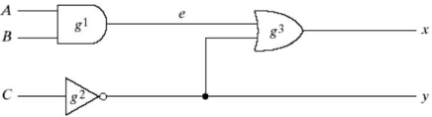
HDL example
module smpl_ckt (A,B,C,x,y);
input A,B,C;
output x,y;
wire e;
and g1(e,A,B);
not g2(y,c);
or g3(x,e,y);
endmodule

Slide 13
Gate Delays
To specify the amount of delay from the input to the output of gates.
In Verilog, the delay is specified in terms of time units and the symbol #.
The association of a time unit with physical time is made using timescale compiler directive.
Compiler directive starts with the “backquote(`)” symbol.
`timescale 1ns/100ps
The first number specifies the unit of measurement for time delays.
The second number specifies the precision for which the delays are rounded off, in this case to 0.1ns.

Slide 14
// Description of circuit with delay
module circuit_with_delay (A,B,C,x,y);
input A,B,C;
output x,y;
wire e;
and #(30) g1(e,A,B);
or #(20) g3(x,e,y);
not #(10) g2(y,C);
endmodule

Slide 15
Simulate a HDL designed circuit with the testbench.
The initial statement specifies inputs between the keyword begin and end.
Initially ABC=000 (A, B and C are each set to 1’b0)
$finish is a system task.

Slide 16
//Stimulus for simple circuit
module stimcrct;
reg A,B,C;
wire x,y;
circuit_with_delay uut(.A(A),.B(B),.C(C),.x(x),.y());
y
initial
begin
A=1’b0; B=1’b0;C=1’b0;
#100
A=1’b1; B=1’b1;C=1’b1;
#100
$finish;
end
endmodule
// Description of circuit with delay
module circuit_with_delay (A,B,C,x,y);
input A,B,C;
output x,y;
wire e;
and #(30) g1(e,A,B);
or #(20) g3(x,e,y);
not #(10) g2(y,C);
endmodule

Slide 17
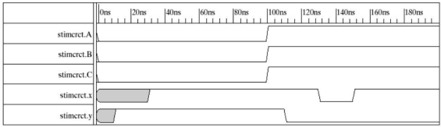

Slide 18
Boolean Expression
In Verilog continuous assignment statement consisting of the keyword assign
The earlier circuit can be specified using the statement:
assign x = ((A&B) | ~C)
E.g. x = A + BC + B’D
y = B’C + BC’D’

Slide 19
//circuit specified with Boolean expression
module circuit_bln (x,y,A,B,C,D);
input A,B,C,D;
output x,y;
assign x = A | (B & C) | (~B & C);
assign y = (~B & C) | (B & ~C & ~D);
endmodule

Slide 20
User defined Primitives (UDP)
The logic gates used in HDL with keywords and, or, etc., are defined by the system are referred as system primitives.
The user can create additional primitives by defining them in tabular form.
These type of circuits are referred to as user-defined primitives.
Do not use keyword module. Start with the keyword primitive.
There can be only one output and many inputs
The truth table is enclosed within the keyword table and endtable.
Inputs listed with a colon (:) the output at the end of the row followed by semicolon(;).
End with keyword endprimitive.

Slide 21
//user defined primitive
primitive crctp (x,A,B,C);
output x;
input A,B,C;
//Truth table for x(A,B,C) = Minterms (0,2,4,6,7)
table
// A B C : x
0 0 0 : 1;
0 0 1 : 0;
0 1 0 : 1;
0 1 1 : 0;
1 0 0 : 1;
1 0 1 : 0;
1 1 0 : 0;
1 1 1 : 1;
endtable
endprimitive
// Instantiate primitive
module declare_crctp;
reg x,y,z;
wire w;
crctp (w,x,y,z);
endmodule

Slide 22
A module can be described in any one of the following modeling techniques.
Gate-level modeling: using instantiation of primitive gates and user defined modules.
Circuit describes by the gate and connections.
Dataflow modeling: continuous assignment statements with the keyword assign.
Describing combinational circuits.
Behavioral modeling: procedural assignment statements with keyword always.
Describes the digital systems at a higher level of abstraction.

Slide 23
Gate-Level Modeling
Circuit is specified by its logic gates and their interconnections.
It provides a textual description of a schematic diagram.
Verilog recognizes 12 basic gates as predefined primitives.
4 primitive gates of 3-state type.
Other 8 : and, or, nand, nor, xor, xnor, not, buf.
When the gates are simulated, the system assigns a four valued logic set to each gate
0,1,X (unknown) and Z (high impedance)

Slide 24
Modeling with vector data:
e.g. output [0:3] D;
wire[7:0] SUM;
There are two basic types of design methodologies:
Top down
E.g. 4-bit binary adder –> 4 FAs –> 2 HA (FA)
Bottom up.
E.g: HA-> FA-> 4-bit binary adder

Slide 25
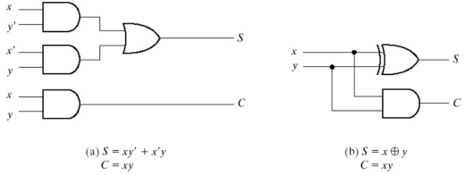
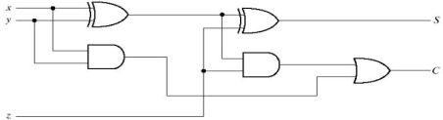

Slide 26
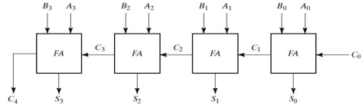

Slide 27
//gate-level modeling of 4-bit adder
module halfadder (S,C,x,y);
input x,y;
output S,C;
xor (S,x,y); //assign S = x ^ y;
and (C,x,y); //assign C = x & y;
endmodule
module fulladder (S,C,x,y,z)
input x,y,z;
output S,C;
wire S1,D1,D2;
halfadder HA1(S1, D1, x,y), HA2(S,D2,S1,z);
or g1(C,D2,D1);
endmodule

Slide 28
module 4bit_adder (S,C4,A,B,C0);
input [3:0] A,B;
input C0;
output [3:0] S;
output C4;
wire C1,C2,C3;
fulladder FA0(S[0],C1,A[0],B[0],C0),
FA1(S[1],C2,A[1],B[1],C1),
FA2(S[2],C1,A[2],B[2],C2),
FA3(S[3],C2,A[3],B[3],C3);
endmodule

Slide 29
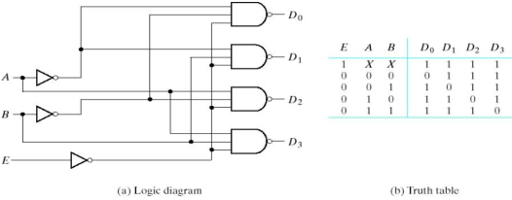
2 to 4 Decoder

Slide 30
module decoder_g1 (A,B,E,D);
input A,B,E;
output [0:3] D;
wire Anot,Bnot,Enot;
not
n1(Anot,A),
n1(Bnot,B),
n1(Enot,E);
nand
n4(D[0],Anot,Bnot,Enot),
n5(D[1],Anot,B,Enot),
n6(D[2],A,Bnot,Enot),
n7(D[3],A,B,Enot);
endmodule

Slide 31
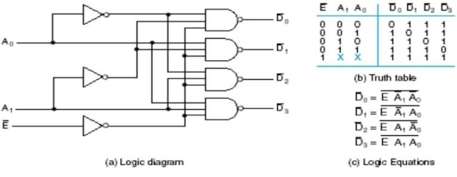
2 to 4 line Decoder

Slide 32
//2 to 4 line decoder
module decoder_2_to_4_line (E_n, A0, A1, D0_n, D1_n, D2_n, D3_n);
input E_n, A0, A1;
output D0_n,D1_n,D2_n,D3_n;
wire A0_n,A1_n,E;
not g0(A0_n,A0), g1(A1_n,A1), g2(E,E_n);
nand g3(D0_n,A0_n,A1_n,E), g4(D1_n,A0,A1_n,E), g5(D2_n,A0_n,A1,E), g6(D3_n,A0,A1,E);
endmodule

Slide 33
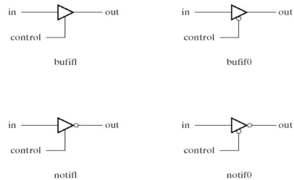
Three-State Gates

Slide 34
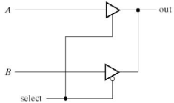
module muxtri (A,B,select,out);
input A,B,select;
output out;
tri out;
bufif1 (out,A,select);
bufif0 (out, B, select);
endmodule

Slide 35
Keywords wire and tri are examples of net data type.
Nets represent connections between hardware elements.
The word net is not a keyword, but represents a class of data types such as wire, wor, wand, tri, supply1, supply0.
The wire declaration is used most frequently
The net wor models the hardware implementation of the wired-OR configuration.
The wand models the wired-AND configuration.
The nets supply1 and supply0 represent power supply and ground

Slide 36
Dataflow Modeling
It uses a number of operations that act on operands to produce desired results.
Verilog provides about 30 operator types.
Keyword assign is used for continuous assignments
A continuous assignment is a statement that assigns a value to a net.
The value assigned to the net is specified by an expression that uses operands and operators.

Slide 37
//Dataflow model of 2-to-4 line decoder
module decoder_df(A,B,E,D)
input A,B,E;
output [0:3] D;
assign D[0] = ~(~A & ~B & ~E),
D[1] = ~(~A & B & ~E),
D[2] = ~(A & ~B & ~E),
D[3] = ~(A & B & ~E),
endmodule

Slide 38
//DF of 4-bit adder
module binary_adder (A, B, Cin, SUM, Cout);
input [3:0] A,B;
input Cin;
output [3:0] SUM;
output Cout;
assign {Cout,SUM} = A + B + Cin;
endmodule
//DF of 4-bit comparator.
module comp_df (A,B,ALTB, AGTB,AEQB);
input [3:0] A,B;
output ALTB, AGTB, AEQB;
assign ALTB = (A < B),
AGTB = (A > B),
AEQB = (A == B);
endmodule

Slide 39
Conditional operator (?:)
Condition ? true-expression : false-expression;
//DF of 2-to-1 line Mux
module mux2x1_df (A, B, select, OUT);
input A, B, select;
output OUT;
assign OUT = select ? A : B;
endmodule

Slide 40
Behavioral Modeling
It represents digital circuits at a functional and algorithmic level.
It is used mostly to describes sequential circuits.
Keyword always followed by list of procedural assignment statements.
The output of procedural assignment must be reg data type.

Slide 41
//BM of 2-to-1 line mux
module mux2x1_bm (A,B,select,OUT);
input A, B, select;
output OUT;
reg OUT;
always @(select or A or B)
if (select == 1) OUT = A;
else OUT = B;
endmodule

Slide 42
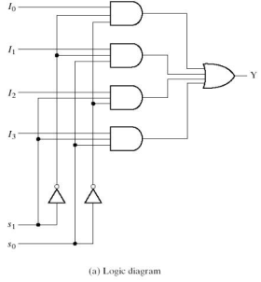

4-to-1 Mux

Slide 43
//BM of 4-to1 line mux
module mux4x1_bm (i0,i1,i2,i3,select,y);
input i0,i1,i2,i3;
input [1:0] select;
output y;
reg y;
always @(i0 or i1 or i2 or i3 or select)
case (select)
2`b00: y =i0;
2`b01: y =i1;
2`b10: y =i2;
2`b11: y =i3;
endcase
endmodule

Slide 44
To display numerical output using Verilog system tasks.
$display – display one time value of variables or strings with end of line return.
$write – same $display but without going to next line.
$monitor- display variables whenever a value changes during simulation run.
$time – displays simulation time
$finish – terminates the simulation
Syntax:Task-name(format-specification, argument list);
e.g. $display(%d %b %b, C,A,B);
$display(“time = %0d A=%b B=%b”, $time,A,B);

Slide 45
//stimulus for mux2x1_df
module testmx;
reg TA,TB,TS;
wire Y;
mux2x1_df mx(TA,TB,TS,Y)
initial
begin
$monitor(“select=%b A=%b B=%b OUT=%b”, TS, TA, TB, Y);
TS =1; TA = 0; TB = 1;
#10 TA = 1; Tb = 0;
#10 TS = 0;
#10 TA = 0; TB = 1;
end
endmodule

Slide 46
Descriptions of Circuits
Structural Description – this is directly equivalent to the schematic of a circuit and is specifically oriented to describing hardware structures using the components of a circuit.
Dataflow Description – this describes a circuit in terms of function rather than structure and is made up of concurrent assignment statements or their equivalent.
Behavioral Description – this refers to a description of a circuit at a level higher than the logic level. This type of description is also referred to as the register transfers level.
Hierarchical Description –it represents the circuits using hierarchy have multiple modules, one for each element of the hierarchy.

Slide 47
//2-to4 line decoder : Dataflow
module dec_2_to_4_df (E_n,A0,A1,D0_n,D1_n,D2_n,D3_n);
input E_n, A0,A1;
output D0_n, D1_n, D2_n, D3_n;
assign D0_n = ~(~E_n&~A1&~A0);
assign D1_n = ~(~E_n&~A1&A0);
assign D2_n = ~(~E_n&A1&~A0);
assign D3_n = ~(~E_n&A1&A0);
endmodule

Slide 48
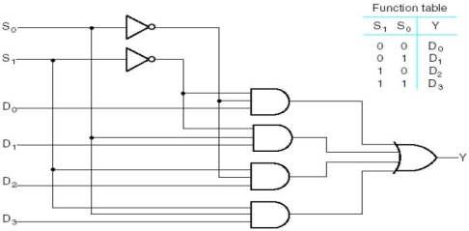
4-to1 Mux

Slide 49
//4-to-1 Mux: Structural
module mux_4_to_1_st_v (S,D,Y);
input [1:0]S;
input [3:0]D;
output Y;
wire [1:0] not_s;
wire [0:3]N;
not g0(not_s[0], S[0],g1(not_S[1],S[1]));
and g1(N[0], not_s[0], not_s[1],D[0]),
g2(N[1], S[0], not_s[1],D[0]),
g3(N[2], not_s[0], S[1],D[0]),
g4(N[3], S[0], S[1],D[0]),
or g5(Y, N[0], N[1], N[2], N[3]),
endmodule

Slide 50
//4-to-1 Mux: DF
module mux_4_to_1 (S,D,Y);
input [1:0] S;
input [3:0] D;
output Y;
assign Y = (~S[1]&~S[0]&D[0])|(~S[1]&S[0]&D[1])
|(S[1]&~S[0]&D[2])|(S[1]&~S[0]&D[3]);
endmodule
//4-to-1 Mux: Conditional DF
module mux_4_to_1(S,D,Y);
input [1:0]S;
input [3:0]D;
output Y;
assign Y = (S==2’b00)?D[0] : (S==2’b01)?D[1] :
(S==2’b10)?D[2] : (S==2’b11)?D[3]:1’bx;
endmodule
//assign Y=S[1]?(S[0]?D[3]:D[2])☹S[0]?D[1]:D[0]);

Slide 51
module adder_4_bit(B,A,C0,S,C4);
input [3:0] B, A;
input C0;
output [3:0]S;
output C4;
wire [3:1] C;
FA Bit0(B[0],A[0],C0,S[0],C[1]),
Bit1(B[1],A[1],C[1],S[1],C[2]),
Bit2(B[2],A[2],C[2],S[2],C[3]),
Bit3(B[3],A[3],C[3],S[3],C4);
endmodule
//4-bit adder:DF
module adder_4bit(A,B<C0,S,C4);
input [3:0]A,B;
input C0;
output [3:0]S;
output C4;
assign {C4,S} = A+B+C0;
endmodule
//4-bit Adder: DF/structural
module HA(x, y, s, c);
input x, y;
output s, c;
assign s= x^y;
assign c = x&y;
endmodule
module FA(x,y,z,s,c);
input x,y,z;
output s,c;
wire hs,hc,tc;
HA HA1(x,y,hs,hc), HA2(hs,z,s,tc);
assign c= tc | hc;
endmodule

Slide 52
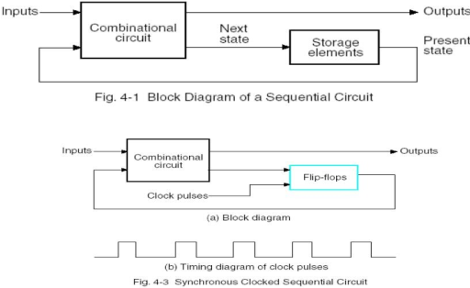
Sequential System Design

Slide 53
An example of free-running clock
initial begin
clock = 1’b0;
repeat (30);
#10 clock = ~clock;
end
initial begin
clock = 1’b0;
#300 $finish;
end
always #10 clock = ~clock

Slide 54
Two kind of events:
Level sensitive (e.g.in combinational circuits and in latches)
always @(A or B or Reset) will cause the execution of the procedural statements in the always block if changes occur in A or B or Reset.
Edge-triggered (in synchronous sequential circuits)
always @(posedge clock or negedge reset) will cause the execution of the procedural statements only if the clock goes through a positive transition or if the reset goes through a negative transition.

Slide 55
A procedural assignment is an assignment within an initial or always statement.
Two types of procedural assignments
Blocking assignment
E.g. B = A;
C = B + 1;
Non-blocking assignment
E.g. B <= A;
C <= B + 1;

Slide 56
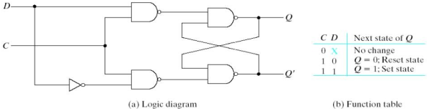
Flip-Flops and Latches
module D_latch(Q, D, control);
output Q;
input D, control;
reg Q;
always @(control or D)
if(control) Q = D;
endmodule

Slide 57
//D flip-flop
module D_FF(Q,D,CLK);
output Q;
input D,CLK;
reg Q;
always@(posedge CLK)
Q = D;
endmodule
//D flip-flop with asynchronous reset
Module DFF (Q,D,CLK,RST);
output Q;
input D,CLK,RST;
reg Q;
always@(posedge CLK or negedge RST)
if(~RST)Q = 1’b0;
else Q = D;
endmodule

Slide 58
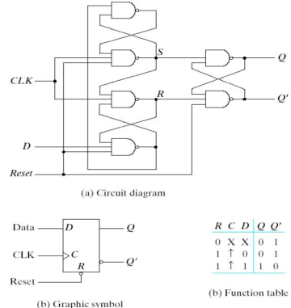
D-FF with reset

Slide 59
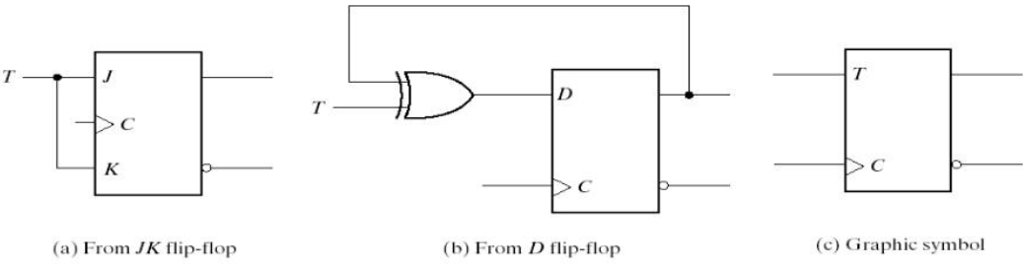
T & J-K FF

Slide 60
//T FF from D FF and gates
module TFF(Q,T,CLK,RST);
output Q;
input T,CLK,RST;
wire DT;
assign DT = Q^T;
DFF TF1(Q,DT,CLK,RST);
endmodule
//JK FF from D FF and gates
module JKFF(Q,J,K,CLK,RST);
output Q;
input J,K,CLK,RST;
wire JK;
assign JK = (J&~Q)|(~K&Q);
DFF JK1(Q,JK,CLK,RST);
endmodule

Slide 61
//Functional description of JK FF
module JK_FF(J,K,CLK,Q,Qnot);
output Q, Qnot;
input J,K,CLK;
reg Q;
assign Qnot = ~Q;
always @(posedge CLK)
case({J,K})
2’b00: Q = Q;
2’b01: Q = 1’b0;
2’b10: Q = 1’b1;
2’b11: Q = ~Q;
endcase
endmodule

Slide 62
//positive edge triggered DFF with reset
module DFF(CLK,RST,D,Q);
input CLK,RST,D;
output Q;
reg Q;
always @(posedge CLK or posedge RST)
if (RST) Q<=0;
else Q<=D;
endmodule

Slide 63
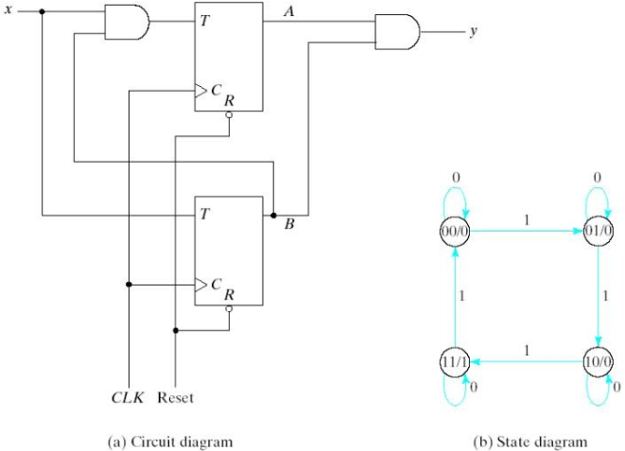
Example Sequential Circuits

Slide 64
//structural description of sequential ckt
module Tckt(x,y,A,B,CLK,RST);
input x,CLK,RST;
output y,A,B;
wire TA,TB;
assign TB = x,
TA = x & B;
assign y = A & B;
T_FF BF (B,TB,CLK,RST);
T_FF AF(A,TA,CLK,RST);
endmodule

Slide 65
//stimulus
module test_Tckt;
reg x,CLK,RST;
wire y,A,B;
Tcircuit TC(x,y,A,B,CLK,RST);
initial begin
RST = 0; CLK = 0;
#5 RST = 1;
repeat (16)
#5 CLK = ~CLK;
end
initial begin
x = 0; #15 x = 1;
repeat (8)
#10 x = ~x;
end
endmodule
//T FF
module T_FF(Q,T,CLK,RST);
output Q;
input T,CLK,RST;
reg Q;
always @(posedge CLK or negedge RST)
if(~RST) Q=1’b0;
else Q=Q^T;
endmodule

Slide 66
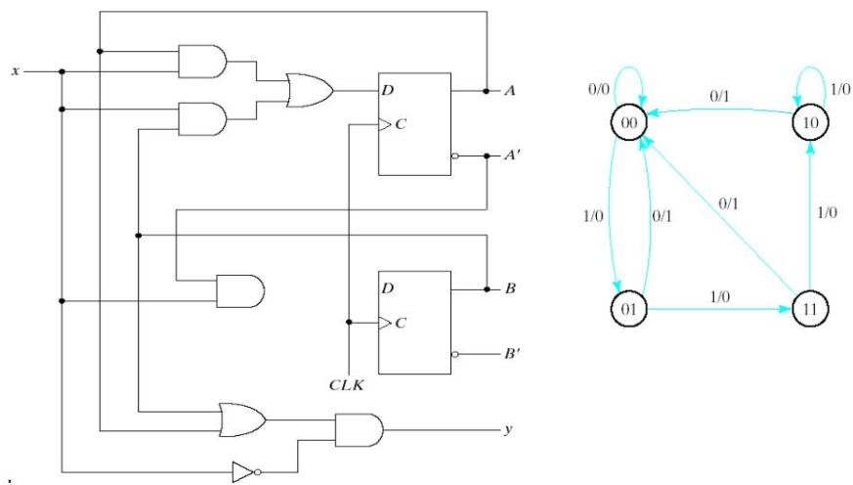
Sequential Circuit Example

Slide 67
//state diagram for the circuit
module state_mdl (x,y, CLK, RST);
input x, CLK,RST;
output y;
reg y;
reg [1:0] Prstate, Nxtstate;
parameter S0=2’b00, S1=2’b01, S2=2’b10, S3=2’b11;
always@(posedge CLK or negedge RST)
if(~RST) Prstate = S0;
else Prstate = Nxtstate;

Slide 68
always @(Prstate or x)
case (Prstate)
S0: if (x) Nxtstate = S1;
S1: if (x) Nxtstate = S3;
else Nxtstate = S0;
s2: if (~x) Nxtstate = S0;
S3: if (x) Nxtstate = S2;
else Nxtstate = S0;
endcase
always@(Prstate or x)
case (Prstate)
S0:y=0;
S1:if(x) y = 1’b0; else y=1’b1;
S2:if(x) y = 1’b0; else y=1’b1;
S3:if(x) y = 1’b0; else y=1’b1;
endcase
endmodule

Slide 69
Structural Model
module xor_gate (out, a, b); input a, b; output out; wire abar, bbar, t1, t2; inverter invA (abar, a); inverter invB (bbar, b); and_gate and1 (t1, a, bbar); and_gate and2 (t2, b, abar); or_gate or1 (out, t1, t2);
endmodule

Slide 70
Simple behavioral model
Continuous assignment
module xor_gate (out, a, b); input a, b; output out;
reg out;
assign #6 out = a ^ b;
endmodule
simulation register - keeps track of value of signal
delay from input change to output change

Slide 71
Simple Behavioral Model
always block
module xor_gate (out, a, b); input a, b; output out; reg out; always @(a or b) begin
#6 out = a ^ b;
end
endmodule
specifies when block is executed I.e., triggered by which signals

Slide 72
Driving a Simulation
module stimulus (x, y); output x, y; reg [1:0] cnt; initial begin cnt = 0; repeat (4) begin #10 cnt = cnt + 1; $display ("@ time=%d, x=%b, y=%b, cnt=%b", $time, x, y, cnt); end #10 $finish; end assign x = cnt[1];
assign y = cnt[0]; endmodule
2-bit vector
initial block executed only once at start of simulation
print to a console
directive to stop simulation

Slide 73

Complete Simulation
Instantiate stimulus component and device to test in a schematic
a
z
x
y
b

Slide 74
Comparator Example
module Compare1 (A, B, Equal, Alarger, Blarger); input A, B; output Equal, Alarger, Blarger; assign #5 Equal = (A & B) | (~A & ~B); assign #3 Alarger = (A & ~B); assign #3 Blarger = (~A & B);
endmodule

Slide 75
More Complex Behavioral Model
module life (n0, n1, n2, n3, n4, n5, n6, n7, self, out); input n0, n1, n2, n3, n4, n5, n6, n7, self; output out; reg out; reg [7:0] neighbors;
reg [3:0] count; reg [3:0] i; assign neighbors = {n7, n6, n5, n4, n3, n2, n1, n0};
always @(neighbors or self) begin count = 0; for (i = 0; i < 8; i = i+1) count = count + neighbors[i]; out = (count == 3); out = out | ((self == 1) & (count == 2)); end
endmodule

Slide 76
Hardware Description Languages vs. Programming Languages
Program Structure
Instantiation of multiple components of the same type
Specify interconnections between modules via schematic
Hierarchy of modules
Assignment
Continuous assignment (logic always computes)
Propagation delay (computation takes time)
Timing of signals is important (when does computation have its effect)
Data structures
Size explicitly spelled out - no dynamic structures
No pointers
Parallelism
Hardware is naturally parallel (must support multiple threads)
Assignments can occur in parallel (not just sequentially)

Slide 77
Hardware Description Languages and Combinational Logic
Modules: specification of inputs, outputs, bidirectional, and internal signals
Continuous assignment: a gate's output is a function of its inputs at all times (doesn't need to wait to be "called")
Propagation delay: concept of time and delay in input affecting gate output
Composition: connecting modules together with wires
Hierarchy: modules encapsulate functional blocks
Specification of don't care conditions (accomplished by setting output to “x”)

Slide 78
Hardware Description Languages and Sequential Logic
Flip-Flops
Representation of clocks - timing of state changes
Asynchronous vs. synchronous
FSMs
Structural view (FFs separate from combinational logic)
Behavioral view (synthesis of sequencers)
Data-paths = ALUs + registers
Use of arithmetic/logical operators
Control of storage elements
Parallelism
Multiple state machines running in parallel
Sequential don't cares

Slide 79
Flip-flop in Verilog
Use always block's sensitivity list to wait for clock edge
module dff (clk, d, q);
input clk, d; output q; reg q;
always @(posedge clk) q = d;
endmodule

Slide 80
More Flip-flops
Synchronous/asynchronous reset/set
Single thread that waits for the clock
Three parallel threads – only one of which waits for the clock
module dff (clk, s, r, d, q); input clk, s, r, d; output q; reg q;
always @(posedge clk) if (reset) q = 1'b0; else if (set) q = 1'b1; else q = d;
endmodule
module dff (clk, s, r, d, q); input clk, s, r, d; output q; reg q;
always @(posedge reset) q = 1'b0; always @(posedge set) q = 1'b1; always @(posedge clk) q = d;
endmodule

Slide 81
Structural View of an FSM
Traffic light controller: two always blocks - flip-flops separate from logic
module FSM (HL, FL, ST, clk, C, TS, TL); output [2:0] HL, FL; reg [2:0] HL, FL; output ST; reg ST; input clk; input C, TS, TL; reg [1:0] present_state; reg [1:0] next_state; initial begin HL = 3'b001; FL = 3'b100; present_state = 2'b00; end
always @(posedge clk) // registers present_state = next_state;
always @(present_state or C or TS or TL) // compute next-state and output logic whenever state or inputs change // put equations here for next_state[1:0], HL[2:0], FL[2:0], and ST // as functions of C, TS, TL, and present_state[1:0] endmodule

Slide 82
Behavioral View of an FSM
Specification of inputs, outputs, and state elements
module FSM(HR, HY, HG, FR, FY, FG, ST, TS, TL, C, reset, Clk); output HR; output HY; output HG; output FR; output FY; output FG; output ST; input TS; input TL; input C; input reset; input Clk; reg [6:1] state; reg ST;
`define highwaygreen 6'b001100 `define highwayyellow 6'b010100 `define farmroadgreen 6'b100001 `define farmroadyellow 6'b100010
assign HR = state[6]; assign HY = state[5]; assign HG = state[4]; assign FR = state[3]; assign FY = state[2]; assign FG = state[1];
specify state bits and codes for each state as well as connections to outputs

Slide 83
Behavioral View of an FSM (cont’d)
initial begin state = `highwaygreen; ST = 0; end always @(posedge Clk) begin if (reset) begin state = `highwaygreen; ST = 1; end else begin ST = 0; case (state) `highwaygreen: if (TL & C) begin state = `highwayyellow; ST = 1; end `highwayyellow: if (TS) begin state = `farmroadgreen; ST = 1; end `farmroadgreen: if (TL | !C) begin state = `farmroadyellow; ST = 1; end `farmroadyellow: if (TS) begin state = `highwaygreen; ST = 1; end endcase end end endmodule
case statement triggerred by clock edge

Slide 84
Timer for Traffic Light Controller
Another FSM
module Timer(TS, TL, ST, Clk); output TS; output TL; input ST; input Clk; integer value; assign TS = (value >= 4); // 5 cycles after reset assign TL = (value >= 14); // 15 cycles after reset always @(posedge ST) value = 0; // async reset always @(posedge Clk) value = value + 1; endmodule

Slide 85
Complete Traffic Light Controller
Tying it all together (FSM + timer)
module main(HR, HY, HG, FR, FY, FG, reset, C, Clk); output HR, HY, HG, FR, FY, FG; input reset, C, Clk; Timer part1(TS, TL, ST, Clk); FSM part2(HR, HY, HG, FR, FY, FG, ST, TS, TL, C, reset, Clk); endmodule

Slide 86
Verilog FSM - Reduce 1s example
Moore machine
`define zero 0 `define one1 1 `define two1s 2 module reduce (clk, reset, in, out); input clk, reset, in; output out; reg out; reg [2:1] state; // state variables reg [2:1] next_state; always @(posedge clk) if (reset) state = `zero; else state = next_state;
state assignment
zero [0]
1
0
0
one1 [0]
0
1
1
two1s
[1]

Slide 87
Moore Verilog FSM (cont’d)
always @(in or state)
case (state) `zero: // last input was a zero begin if (in) next_state = `one1; else next_state = `zero; end `one1: // we've seen one 1 begin if (in) next_state = `two1s; else next_state = `zero; end `two1s: // we've seen at least 2 ones begin if (in) next_state = `two1s; else next_state = `zero; end endcase
crucial to include all signals that are input to state and output equations
note that output only depends on state
always @(state) case (state) `zero: out = 0; `one1: out = 0; `two1s: out = 1; endcase
endmodule

Slide 88
Mealy Verilog FSM
module reduce (clk, reset, in, out); input clk, reset, in; output out; reg out; `register state; // state variables reg next_state; always @(posedge clk) if (reset) state = `zero; else state = next_state; always @(in or state) case (state) `zero: // last input was a zero begin out = 0; if (in) next_state = `one; else next_state = `zero; end `one: // we've seen one 1 if (in) begin next_state = `one; out = 1; end else begin next_state = `zero; out = 0; end endcase endmodule
0/0
zero [0]
0/0
1/0
one1 [0]
1/1

Slide 89
Synchronous Mealy Machine
module reduce (clk, reset, in, out); input clk, reset, in; output out; reg out; reg state; // state variables always @(posedge clk) if (reset) state = `zero; else case (state) `zero: // last input was a zero begin out = 0; if (in) state = `one; else state = `zero; end `one: // we've seen one 1 if (in) begin state = `one; out = 1; end else begin state = `zero; out = 0; end endcase endmodule

